Slide 1
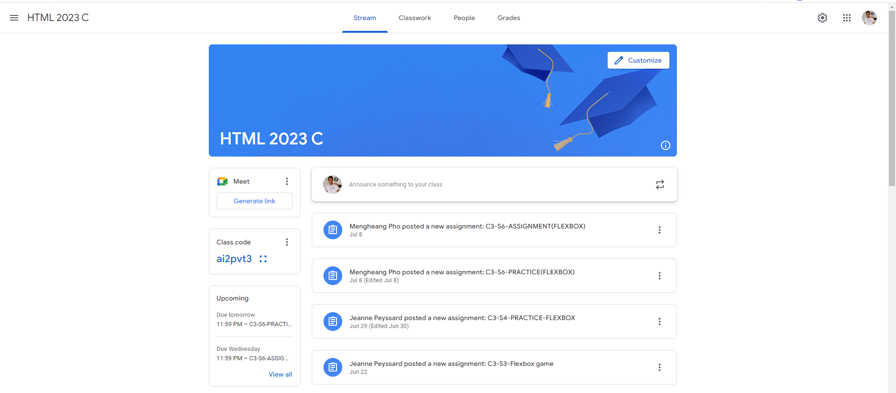
Identify root components of website below

